Slide 1
Clue Number 4 Goes Here
QR Code Here
Station # _____________
Clue Number 2 Goes Here
Clue Number 3 Goes Here
Clue Number 1 Goes Here

Slide 2
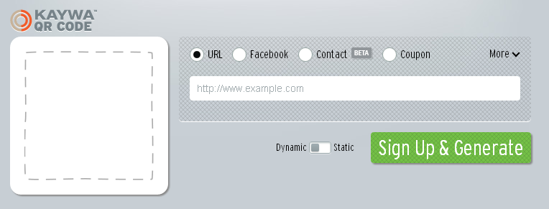
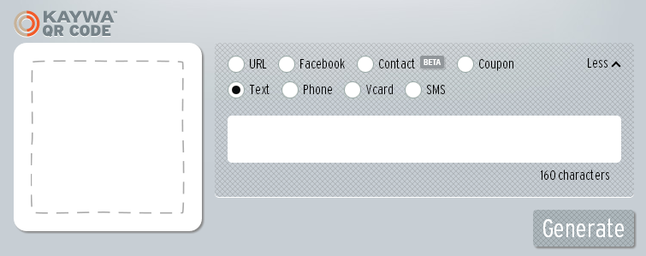
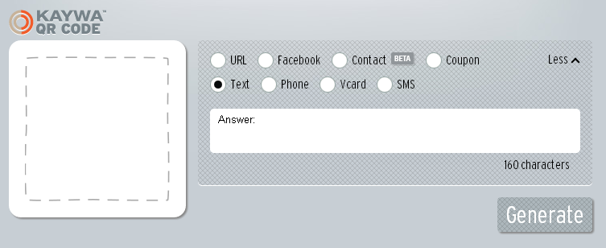
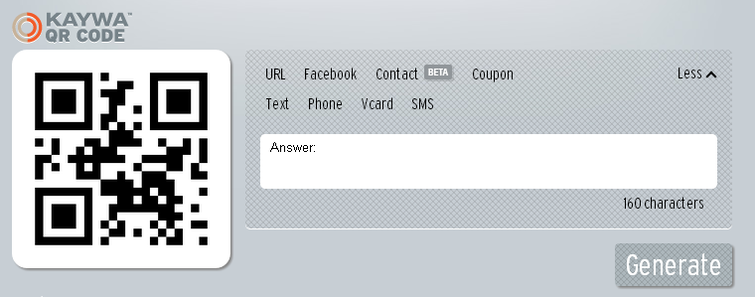
Use the website http://qrcode.kaywa.com/ to create your QR code.
Follow the steps below.
Click on More
Click on Text
Type your answer then click Generate
Copy and Paste into template

